Slide 1
ASSET LOANING APPLICATION
By Amrit Singh

Slide 2
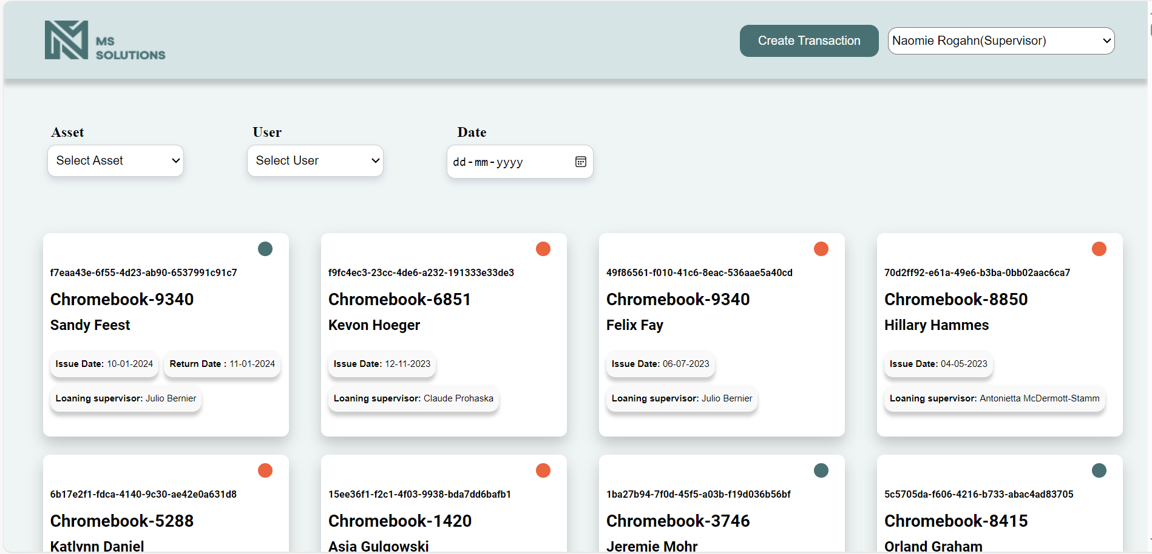
HOME PAGE

Slide 3
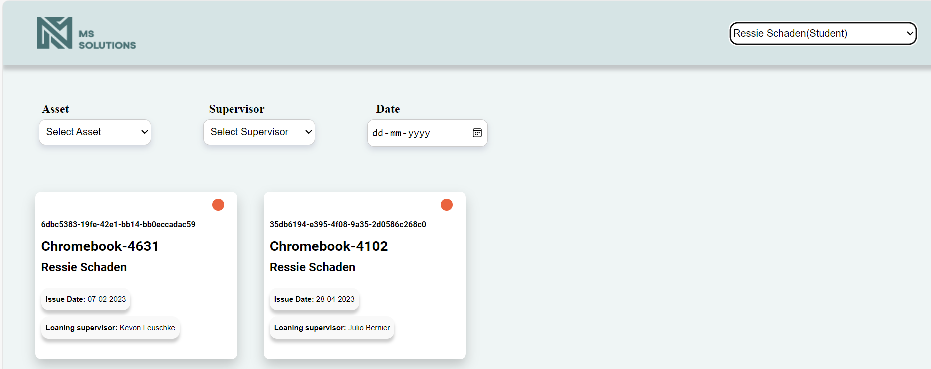
HOME PAGE WHEN STUDENT IS SELECTED

Slide 4
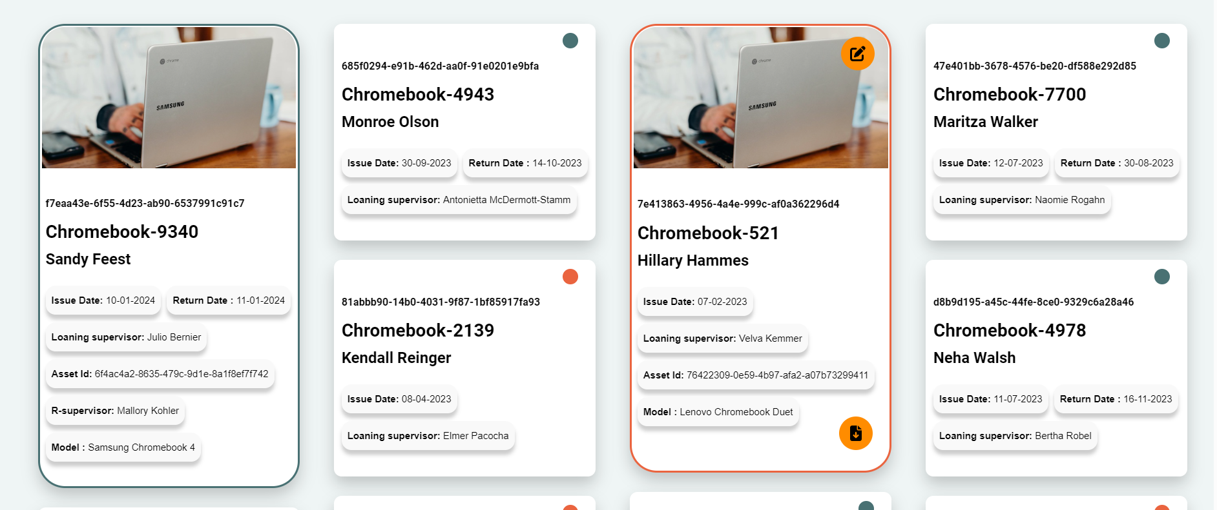
Cards Expanded

Slide 5
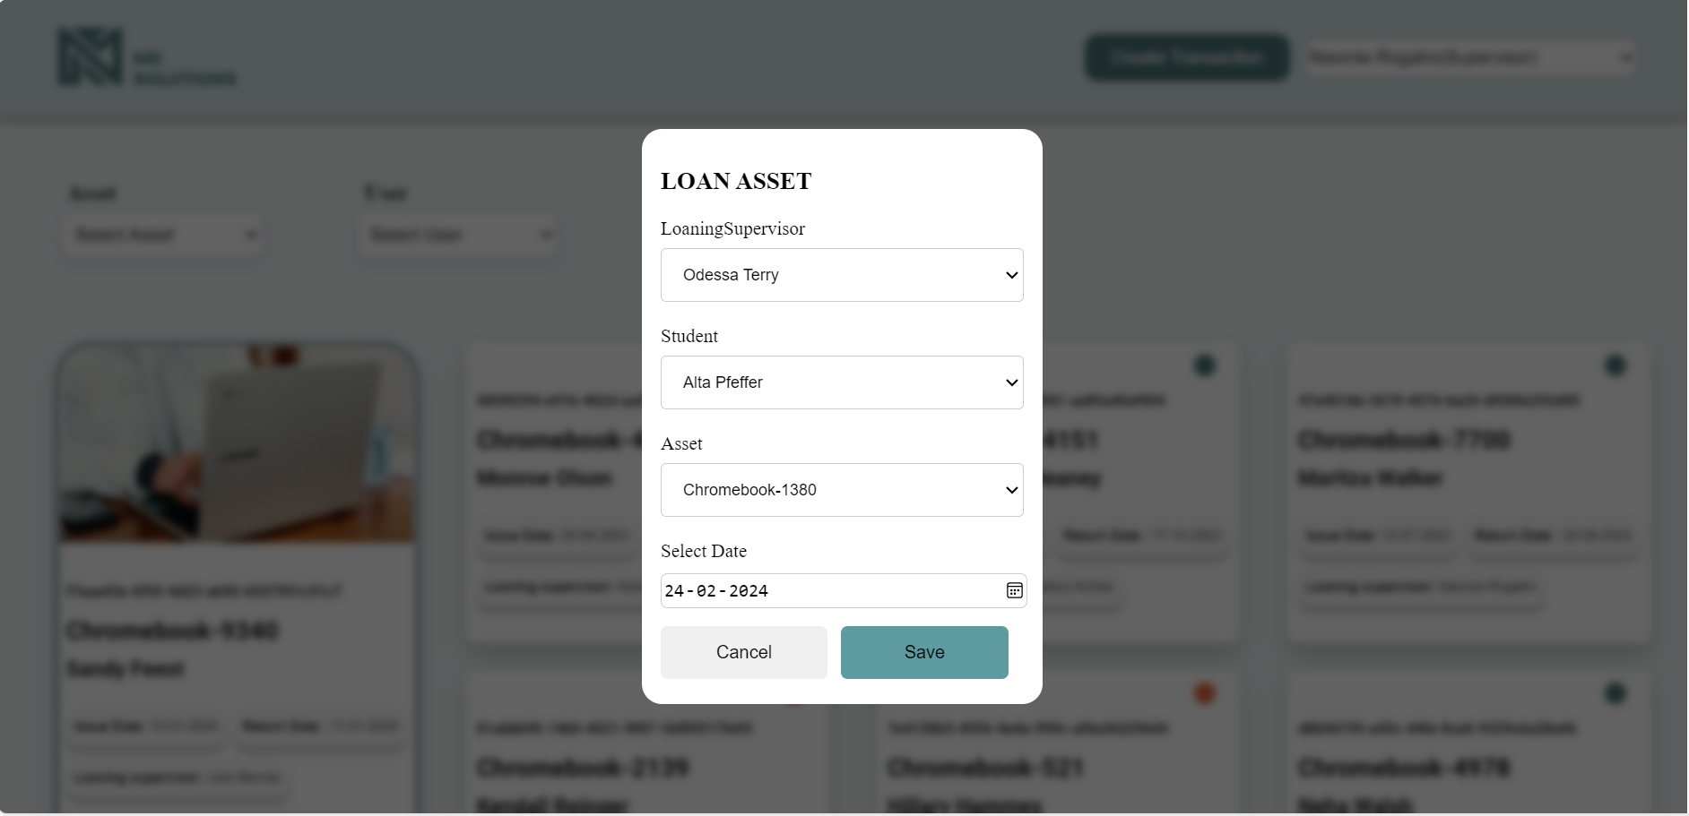
LOAN ASSET FORM

Slide 6
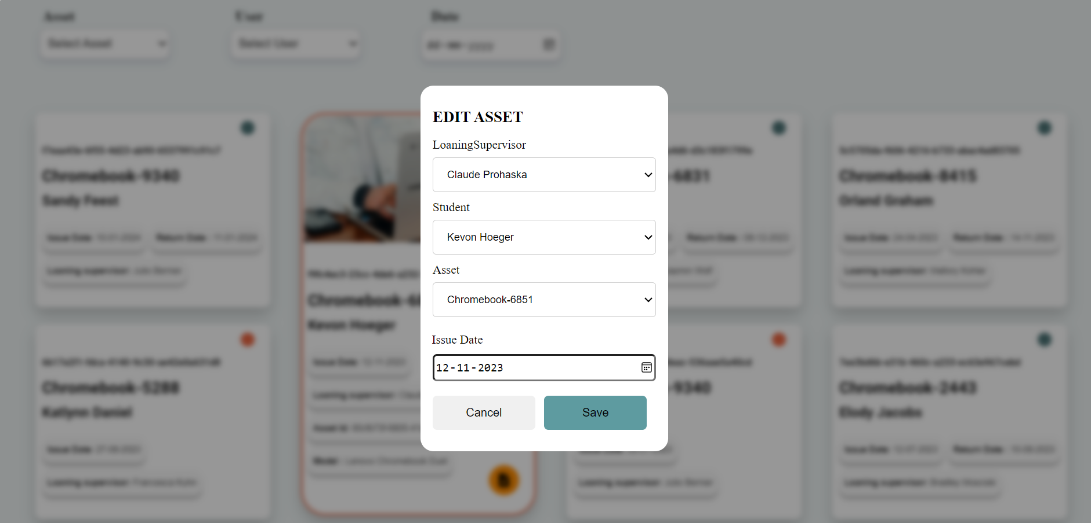
EDIT ASSET FORM

Slide 7
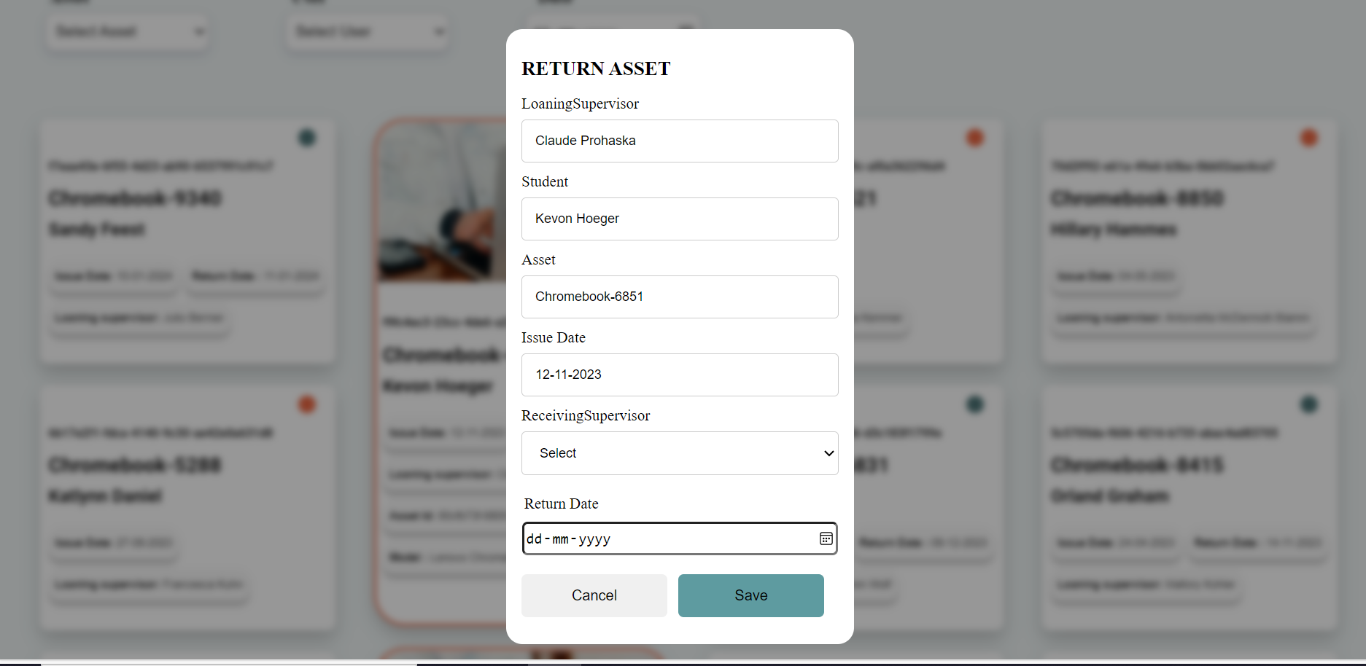
RETURN ASSET FORM

Slide 8
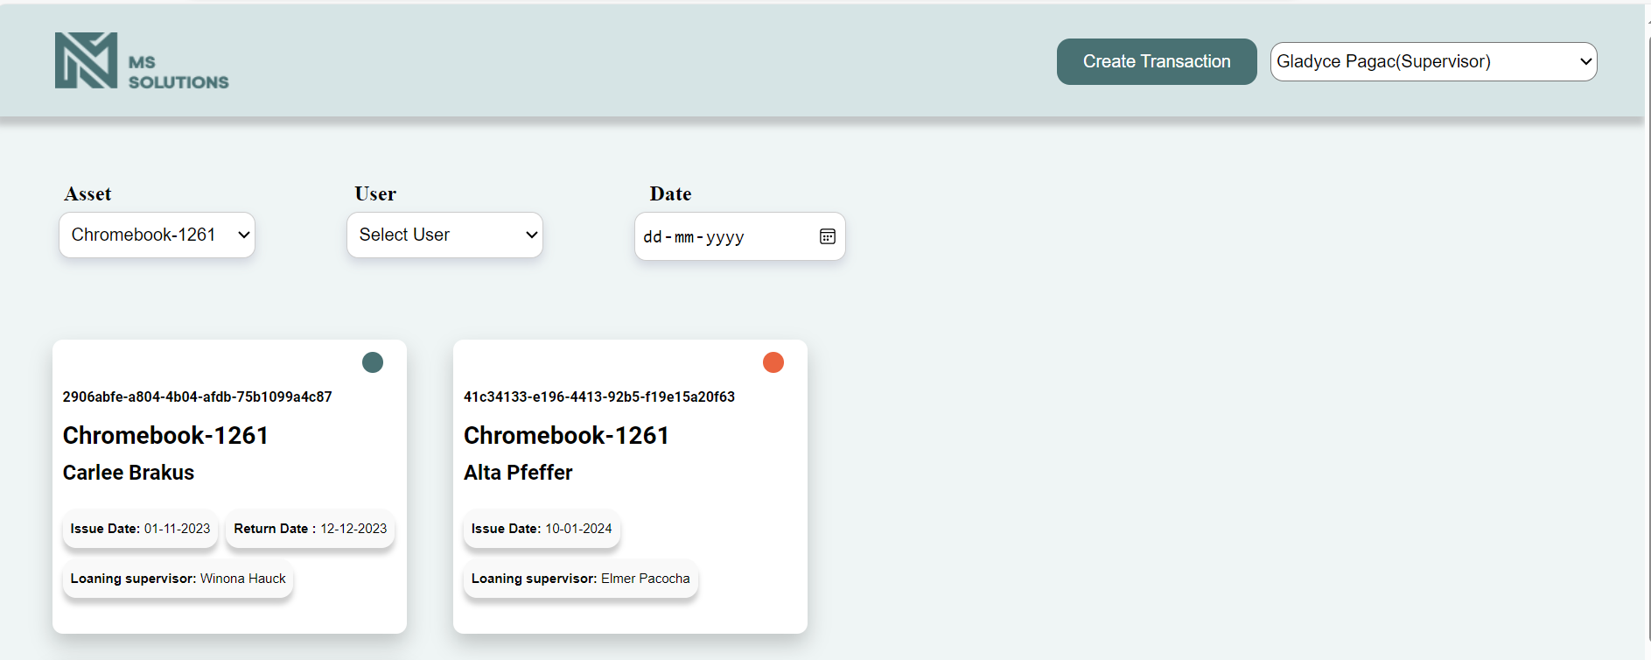
ASSET FILTER

Slide 9
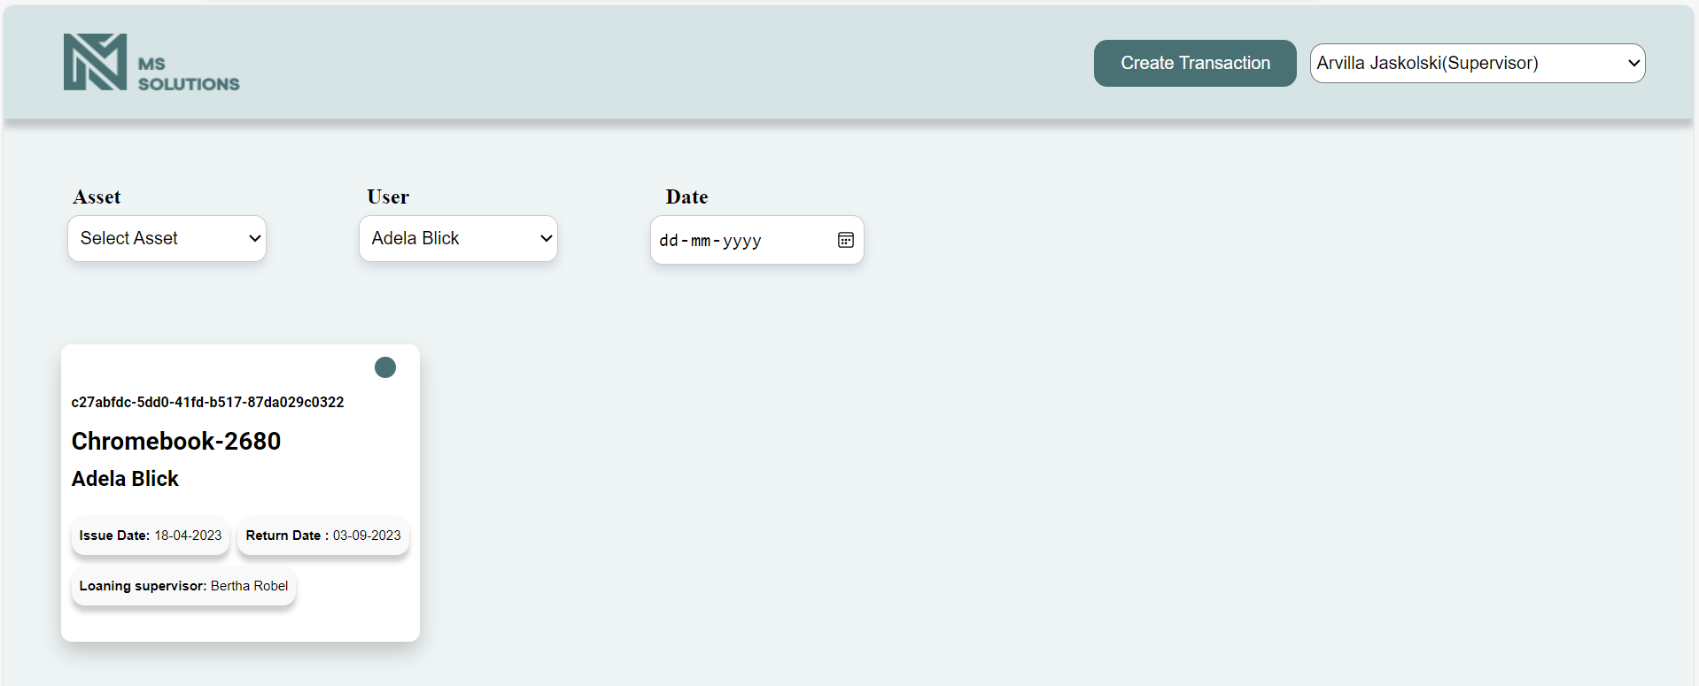
USER FILTER

Slide 10
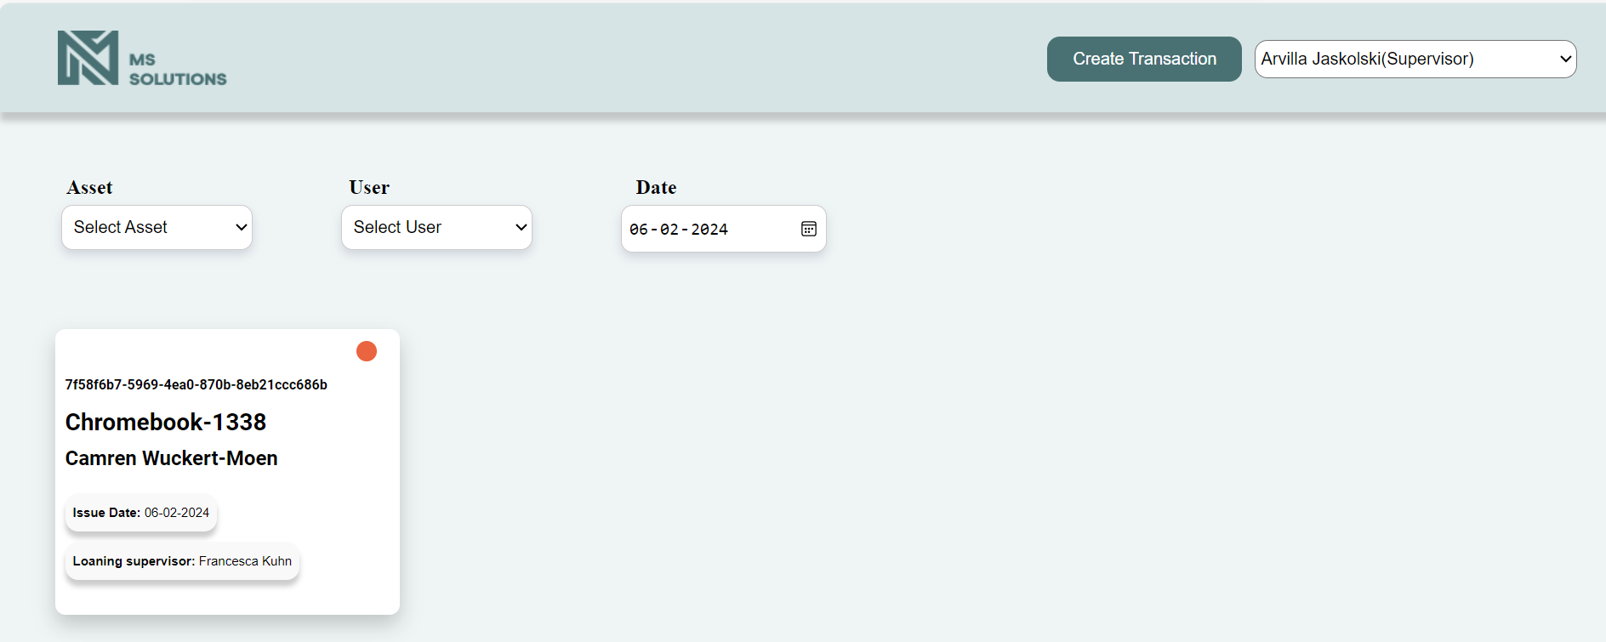
DATE FILTER

Slide 11
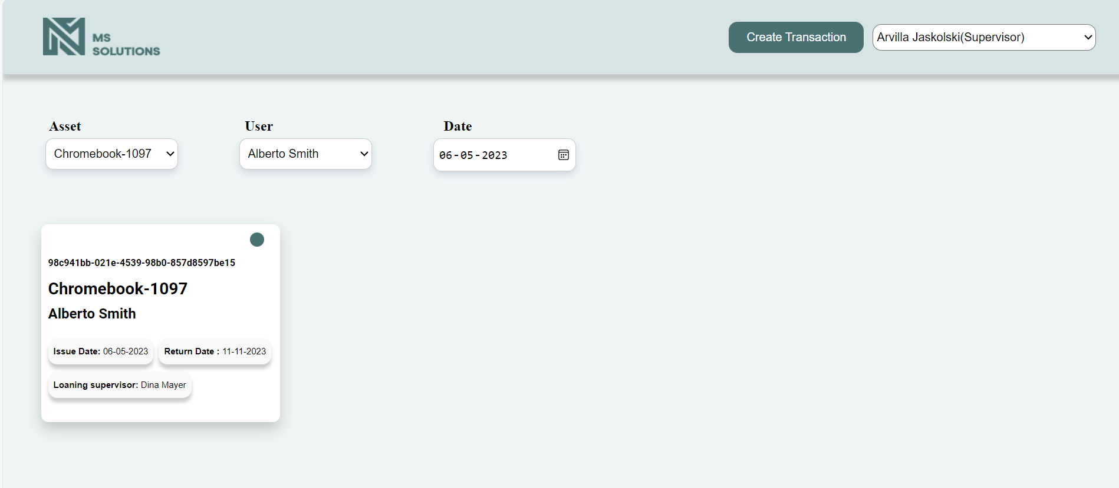
ALL 3 FILTERS

Slide 12
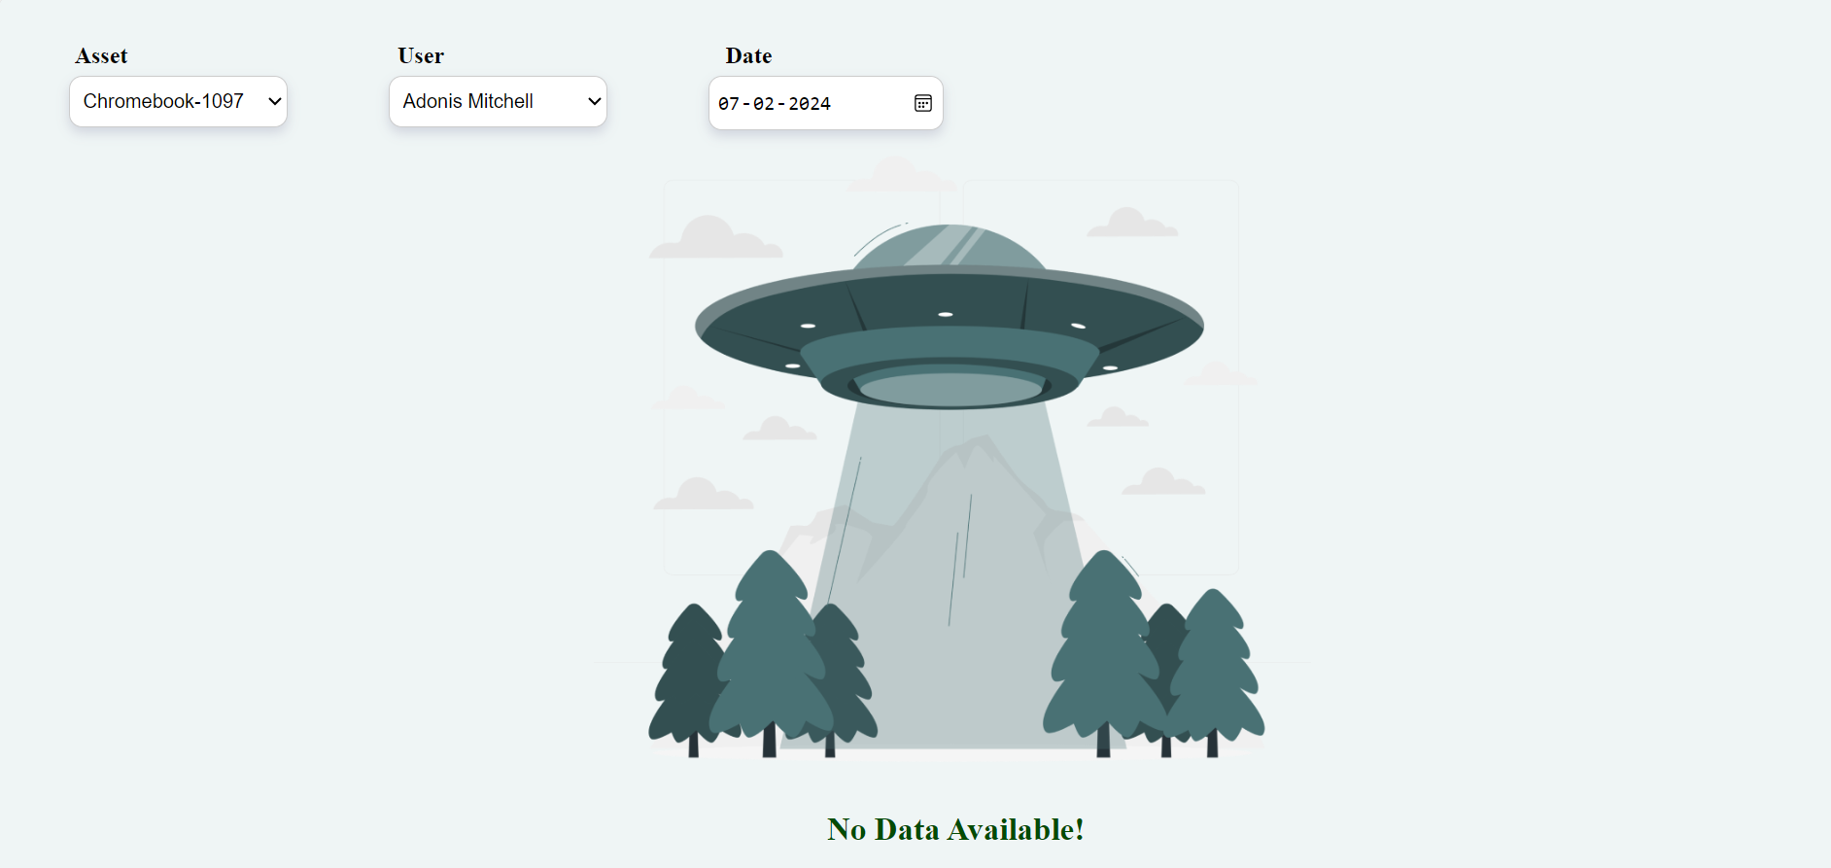
WHEN THERE IS NO DATA AVAILABLE

